Slide 1



Build Interactive Web App with R & Shiny
Part 2 of ShinyApps series
Prepared by : Aep Hidayatuloh
Email : aephidayatuloh.mail@gmail.com
GitHub : https://github.com/aephidayatuloh
RPubs : https://rpubs.com/aephidayatuloh

Slide 2
Basic Shiny App
Layout And Structure Of Shiny

Slide 3

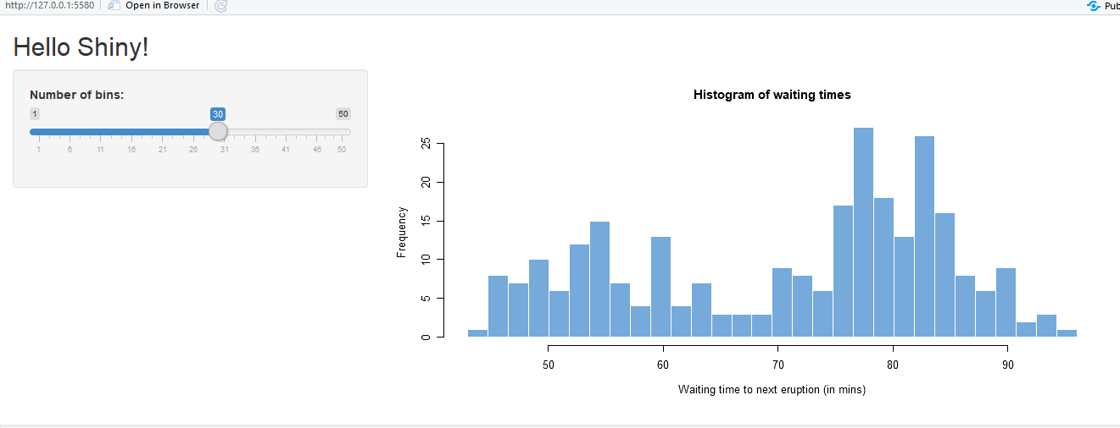
Basic Shiny Apps
Layout
Title/Header Panel
Sidebar/Input Panel
Main/Output Panel

Slide 4
Shiny ui and server
ui
server
User Interface
Computation Processes
User Interface
Control the layout, appearance, widget for user inputs and display the output.
E.g. the title, page layout, text input, radio button, dropdown menu, graphics output etc.
Server
Set of instructions that uses the input provided by user, process them and produces the required output which is further displayed by ui.R

Slide 5
Shiny App Code – Single File
ui & server in a file named app.R
# file app.R
library(shiny)
ui <- fluidPage()
server <- function(input, output <, session>){}
shinyApp(ui, server)
<, session> means session argument is optional

Slide 6
Shiny App Code – Multiple File
ui & server in separated file named ui.R and server.R but in the same folder
# file ui.R
library(shiny)
shinyUI(fluidPage(
)
)
# file server.R
library(shiny)
shinyServer(function(input, output <, session>){
}
)

Slide 7
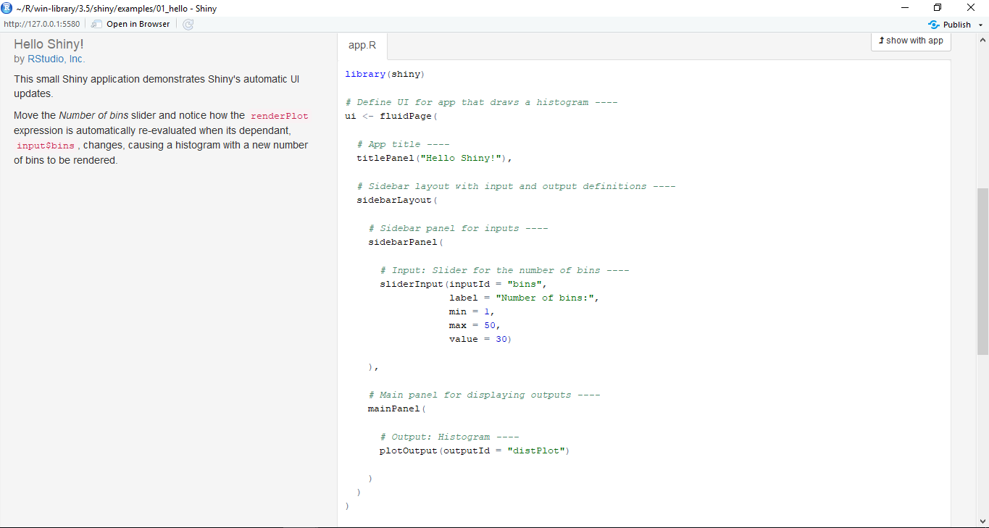
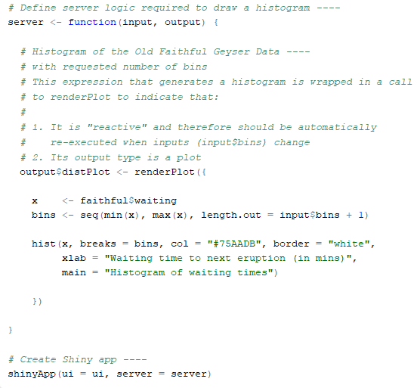
Inspect The App!
Single or Multiple file?

Slide 8
Widgets
Widgets or input user interface allows user to interactively update the value of shiny app

Slide 9
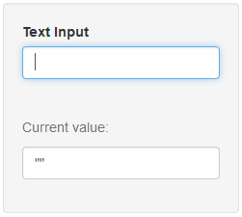
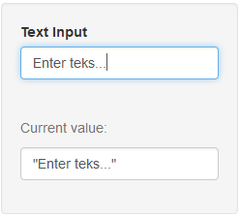
Text Input
textInput(inputId, label, value = "", width = NULL, placeholder = NULL)

Slide 10
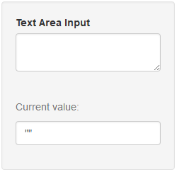
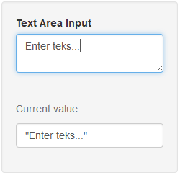
Text Area Input
textAreaInput(inputId, label, value = "", width = NULL, height = NULL,
cols = NULL, rows = NULL, placeholder = NULL, resize = NULL)

Slide 11
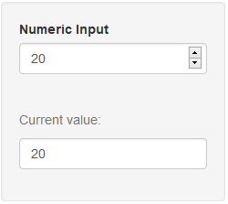
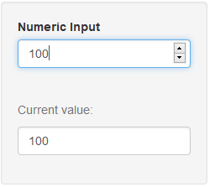
Numeric Input
numericInput(inputId, label, value, min = NA, max = NA, step = NA,
width = NULL)

Slide 12
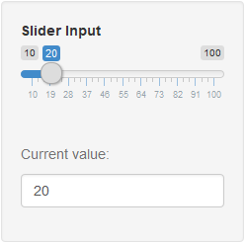
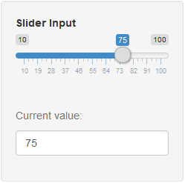
Slider Input
sliderInput(inputId, label, min, max, value, step = NULL, round = FALSE,
format = NULL, locale = NULL, ticks = TRUE, animate = FALSE,
width = NULL, sep = ",", pre = NULL, post = NULL, timeFormat = NULL,
timezone = NULL, dragRange = TRUE)

Slide 13
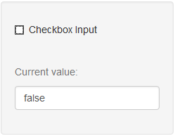
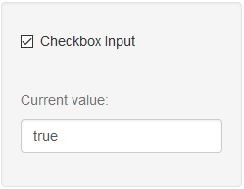
Checkbox Input
checkboxInput(inputId, label, value = FALSE, width = NULL)

Slide 14
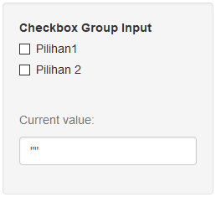
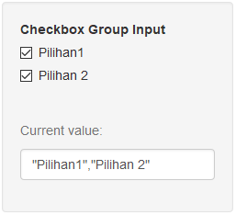
Checkbox Group Input
checkboxGroupInput(inputId, label, choices = NULL, selected = NULL,
inline = FALSE, width = NULL, choiceNames = NULL, choiceValues = NULL)

Slide 15
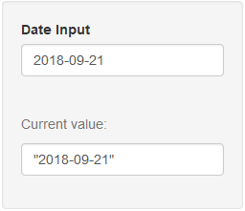
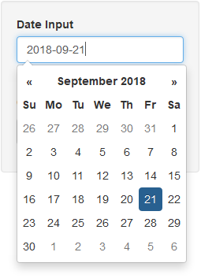
Date Input
dateInput(inputId, label, value = NULL, min = NULL, max = NULL,
format = "yyyy-mm-dd", startview = "month", weekstart = 0,
language = "en", width = NULL, autoclose = TRUE)

Slide 16
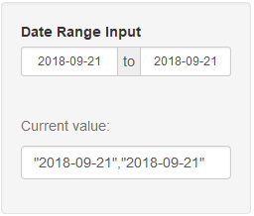
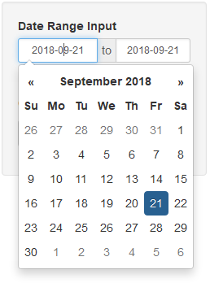
Date Range Input
dateRangeInput(inputId, label, start = NULL, end = NULL, min = NULL,
max = NULL, format = "yyyy-mm-dd", startview = "month", weekstart = 0,
language = "en", separator = " to ", width = NULL, autoclose = TRUE)

Slide 17
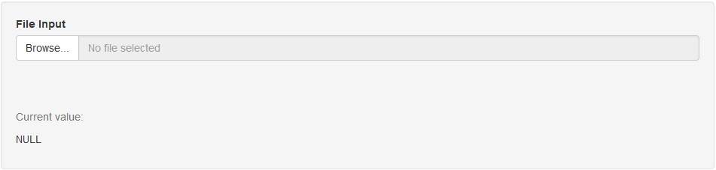
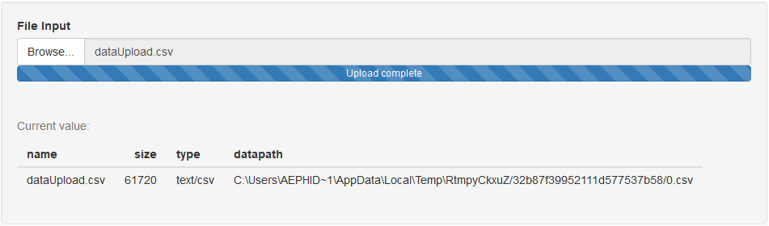
File Input
fileInput(inputId, label, multiple = FALSE, accept = NULL, width = NULL,
buttonLabel = "Browse...", placeholder = "No file selected")

Slide 18
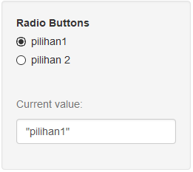
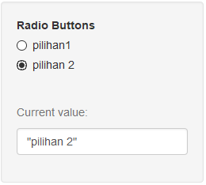
Radio Buttons
radioButtons(inputId, label, choices = NULL, selected = NULL,
inline = FALSE, width = NULL, choiceNames = NULL, choiceValues = NULL)

Slide 19
Multiple File Shiny
Shiny App with Two File, ui.R and server.R

Slide 20
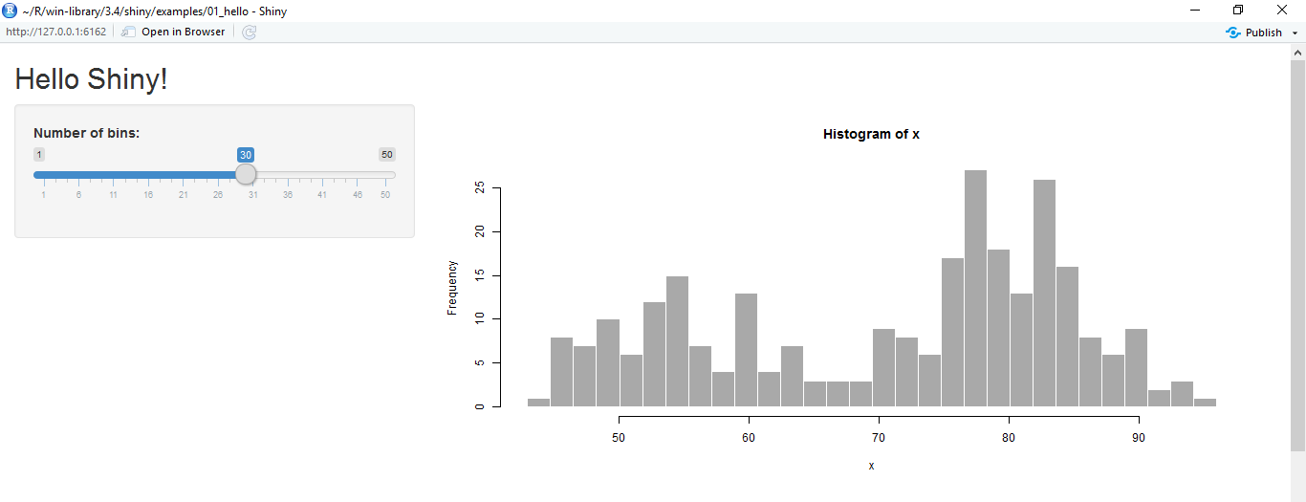
Basic Shiny Apps
Layout
Title/Header Panel
Sidebar/Input Panel
Main/Output Panel
You can create shiny apps with single file app.R or two files ui.R and server.R
ui.R
server.R
User Interface
Computation Processes

Slide 21
Shiny ui.R and server.R
ui.R
server.R
User Interface
Computation Processes
User Interface
Control the layout, appearance, widget for user inputs and display the output.
E.g. the title, page layout, text input, radio button, dropdown menu, graphics output etc.
Server
Set of instructions that uses the input provided by user, process them and produces the required output which is further displayed by ui.R

Slide 22
Shiny App – Multiple File
ui & server in separated file named ui.R and server.R but in the same folder
# file ui.R
library(shiny)
shinyUI(fluidPage(
........
)
)
# file server.R
library(shiny)
shinyServer(function(input, output <, session>){
........
}
)

Slide 23
Create the Brain
All processes are done in server.R.
All generated objects (vector, table, plot, text, UI etc.) based on input should be created in reactive function (reactive(), render*(), observe() etc.).
render*() → *Output()
ui.R | server.R
tableOutput("preview") | output$preview <- renderTable()
uiOutput("graphTitle") | output$graphTitle <- renderUI()
plotOutput("plots") | output$plots <- renderPlot()
printOutput("prints") | output$prints <- renderPrint()
textOutput("text") | output$text <- renderText()

Slide 24


